Slide 1







MeshCentral
HARDWARE TLS
Built with modern web technologies

Slide 2
RemsCentral Overview
Very small agent for the client install
Windows, Linux, MacOS, FreeBSD
Run commands against multiple hosts at once
终端访问、桌面访问
采集主机、系统信息，性能数据
支持RDB SSH VNC…
支持double NAT

Slide 3
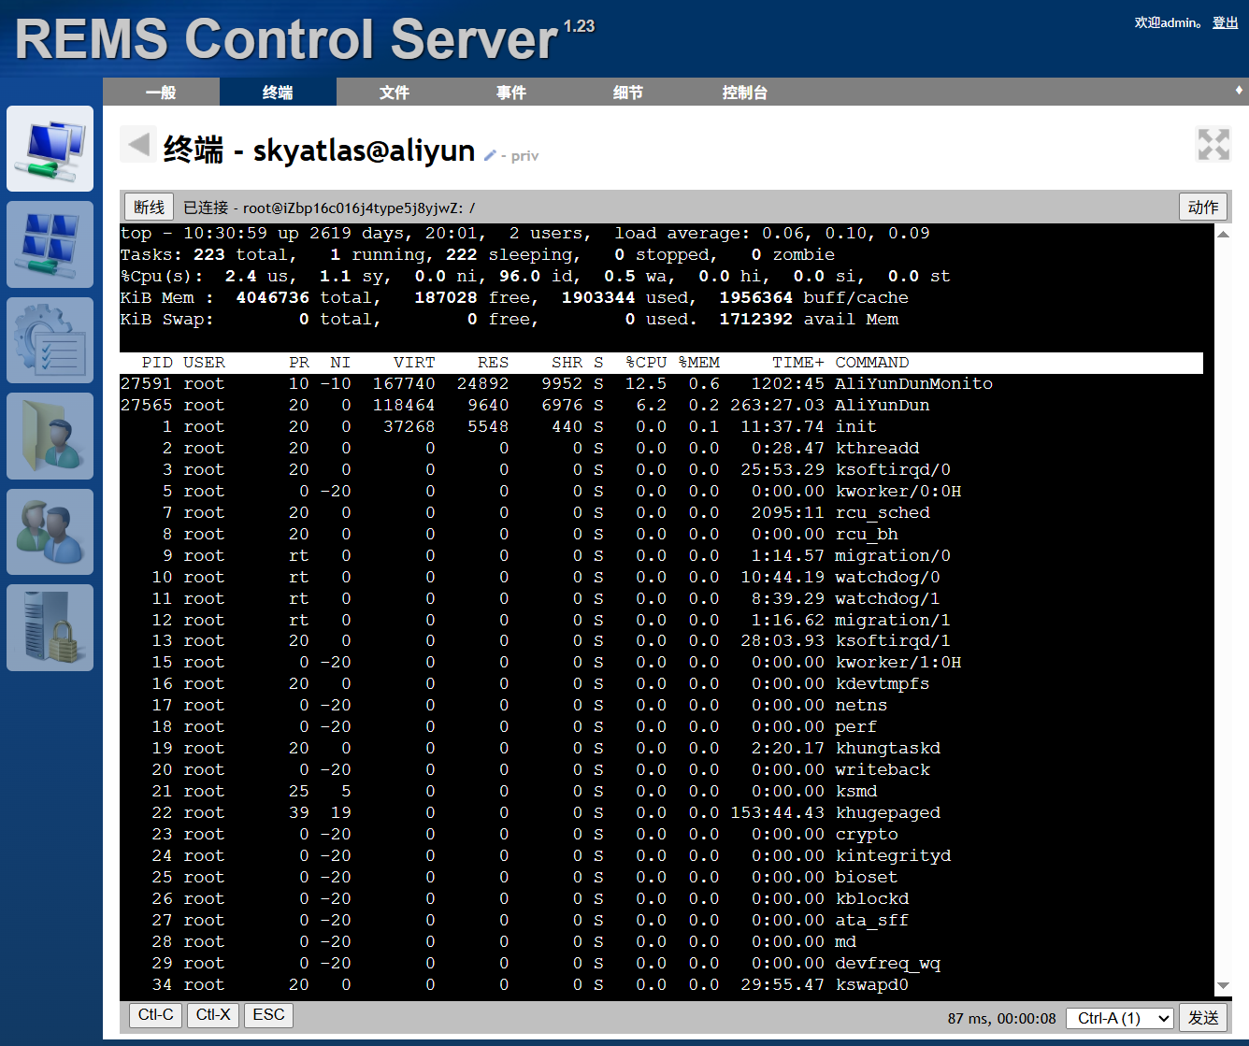
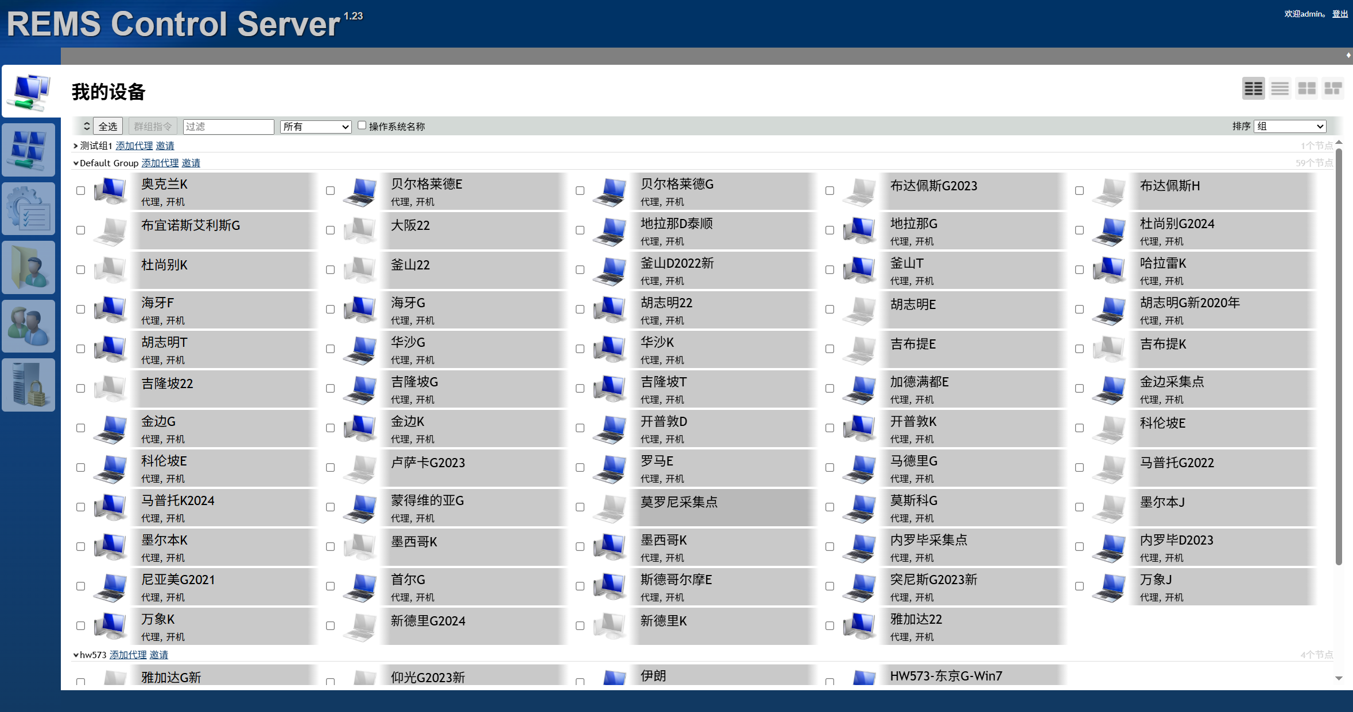
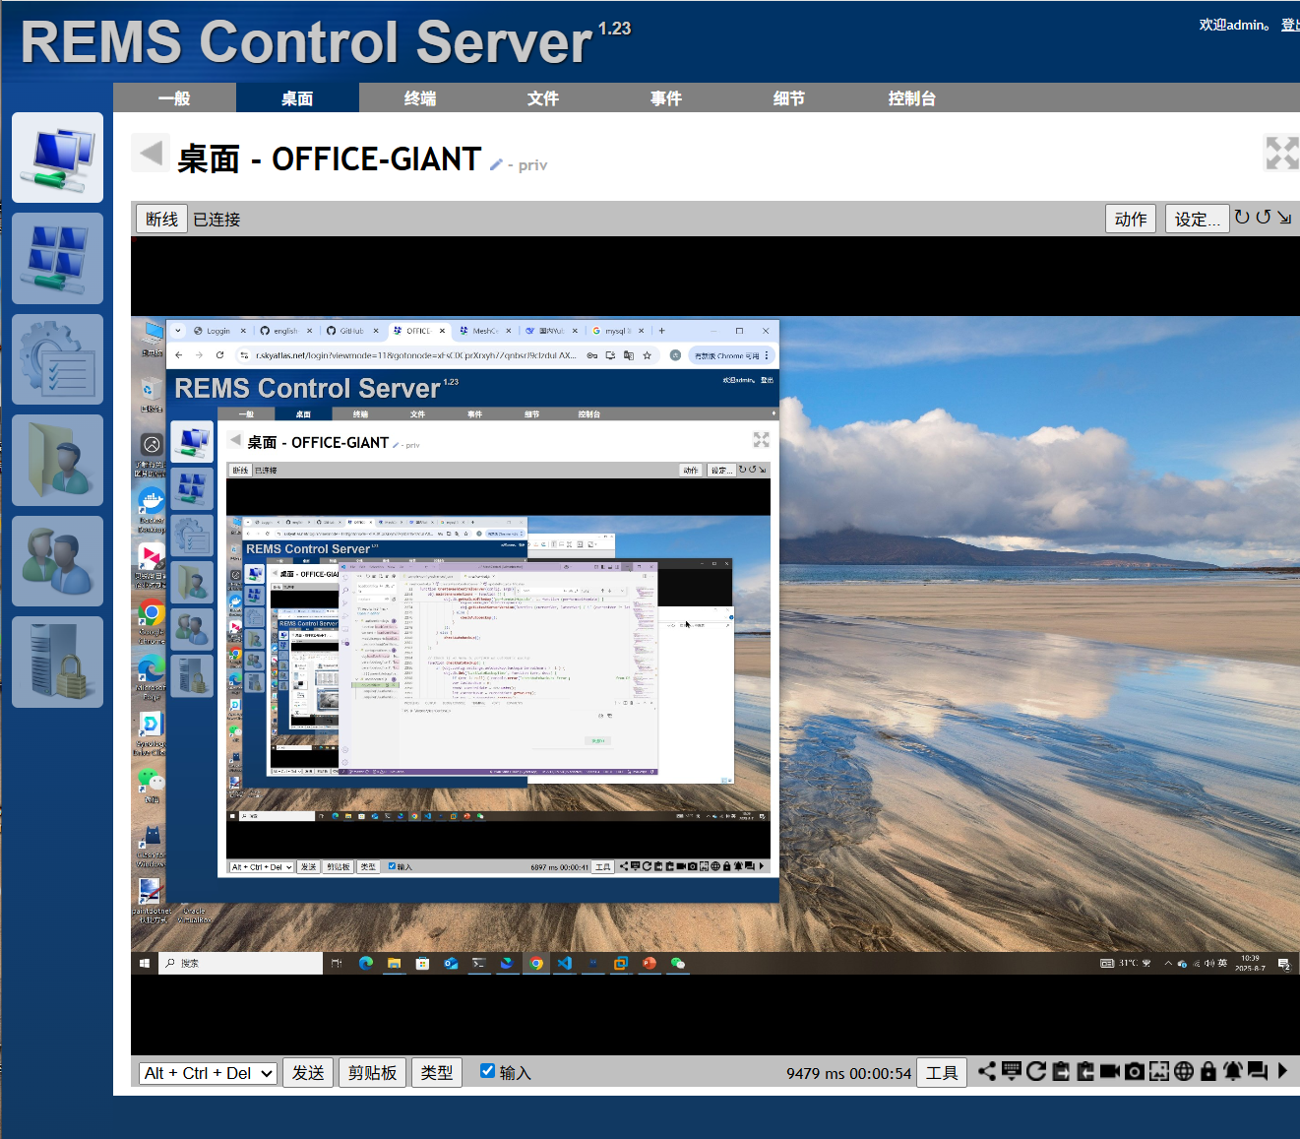
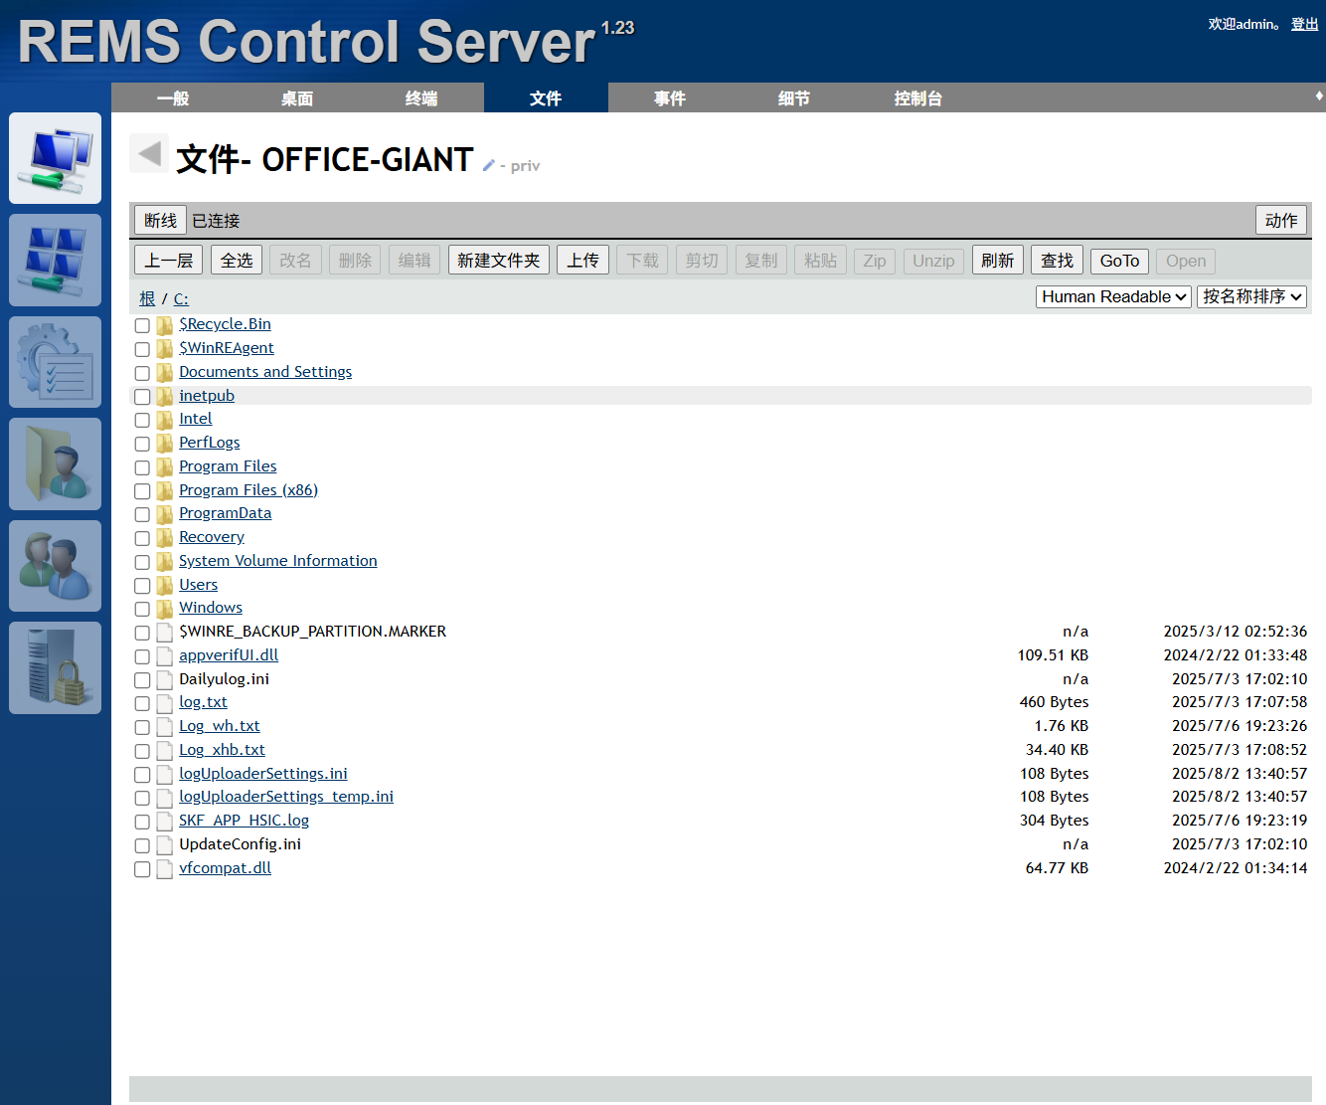
RemsCentral
远程桌面控制
远程文件管理
远程终端访问
设备信息采集
实时用户界面响应
LAN / WAN / Hybrid modes

Slide 4
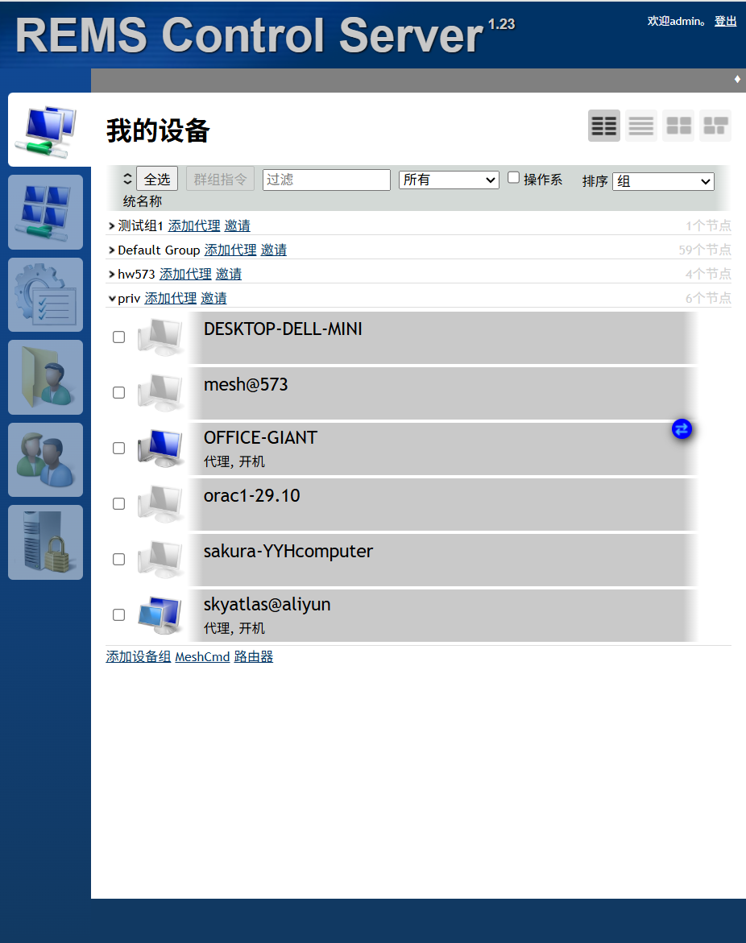
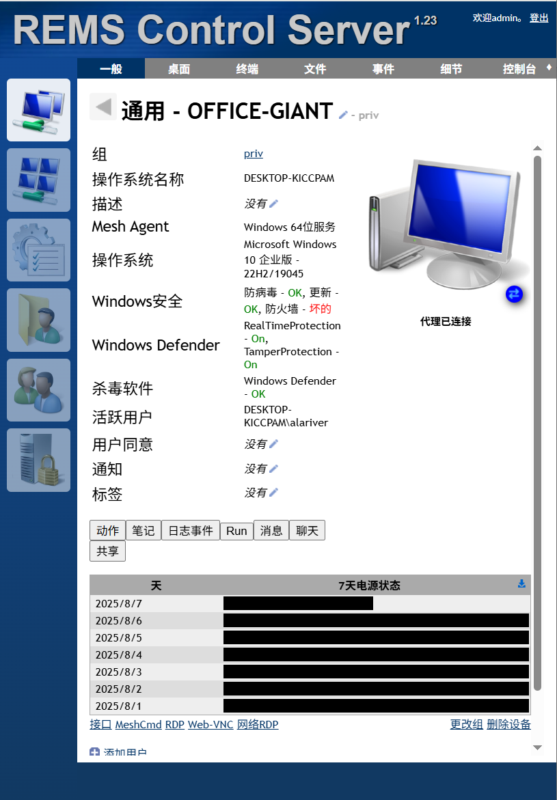
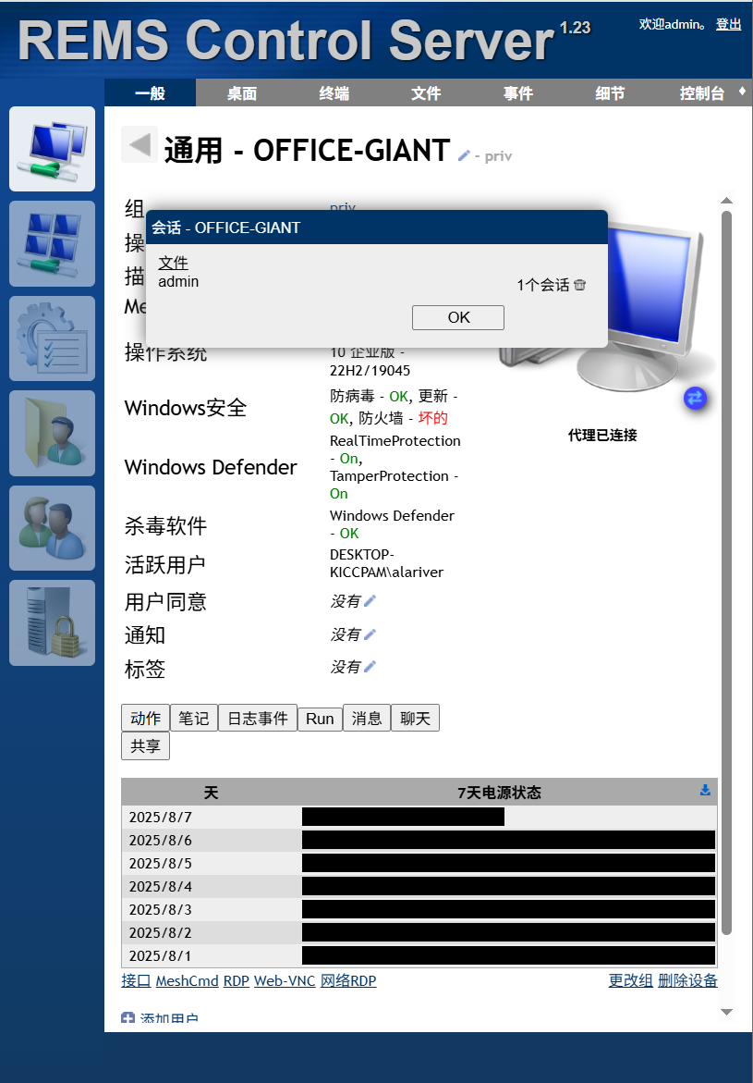
当设备存在“活动”的连接会话时，会显示一个蓝色的图标，表示当前设备存在Active会话。
点击该图标，可以查看该活动会话，也可以终端该会话
这个图标是实时的，其显示不需要刷新页面

Slide 5


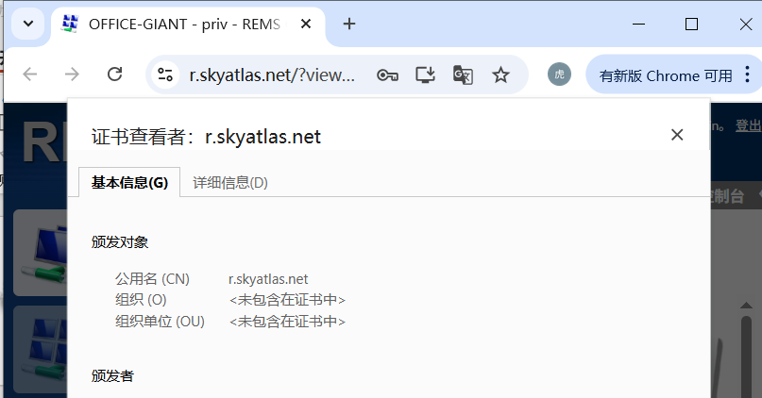
RemsCentral
Register
Prove domain control HTTP:80
Get HTTPS certificate

Slide 6
RemsCentral Security

Slide 7
Top 12 security features
2FA 双因素认证
仅仅密码的保护是不够的
TLS证书加密
强加密算法
SHA384 AES256 RSA3072
高于安全领域的推荐最佳实践
强加密传输协议TLS 1.2
强密码+2FA
数据库记录加密

Slide 8
Top 12 security features
HTTP 内容安全
防止跨站脚本攻击
FIDO2 协议支持
可以使用硬件加密key
IP地址token绑定
所有会话的token、cookies与请求端IP地址绑定
支持使用反向代理
HashCorp Vault支持
强密码Hash算法

Slide 9
支持5中不同2FA
Time Codes
指纹锁
FIDO硬件key
邮件认证
一次性Codes

Slide 10
MeshCentral Assistant

Slide 11
MeshCentral Features

Slide 12

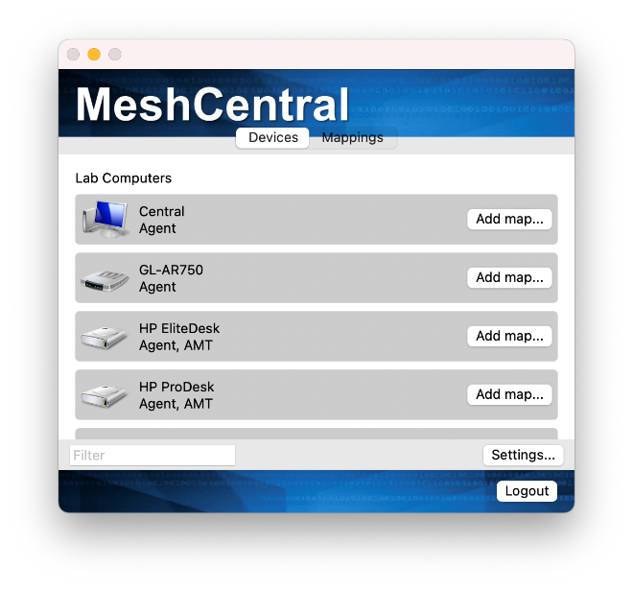
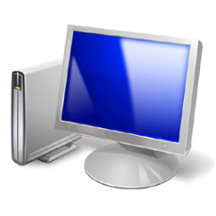
NEW
MeshCentral Router for macOS allows users to map TCP ports across networks thru the MeshCentral server.
“Map my local TCP port 888 to this remote computer’s port 80.“
Both TCP normal port maps and relay port mappings are supported. You can, for example, SSH to a remote computer or access a home router’s web page.
“Map my local TCP port 888 to IP address 192.168.1.1 going thru this remote computer.“

Slide 13
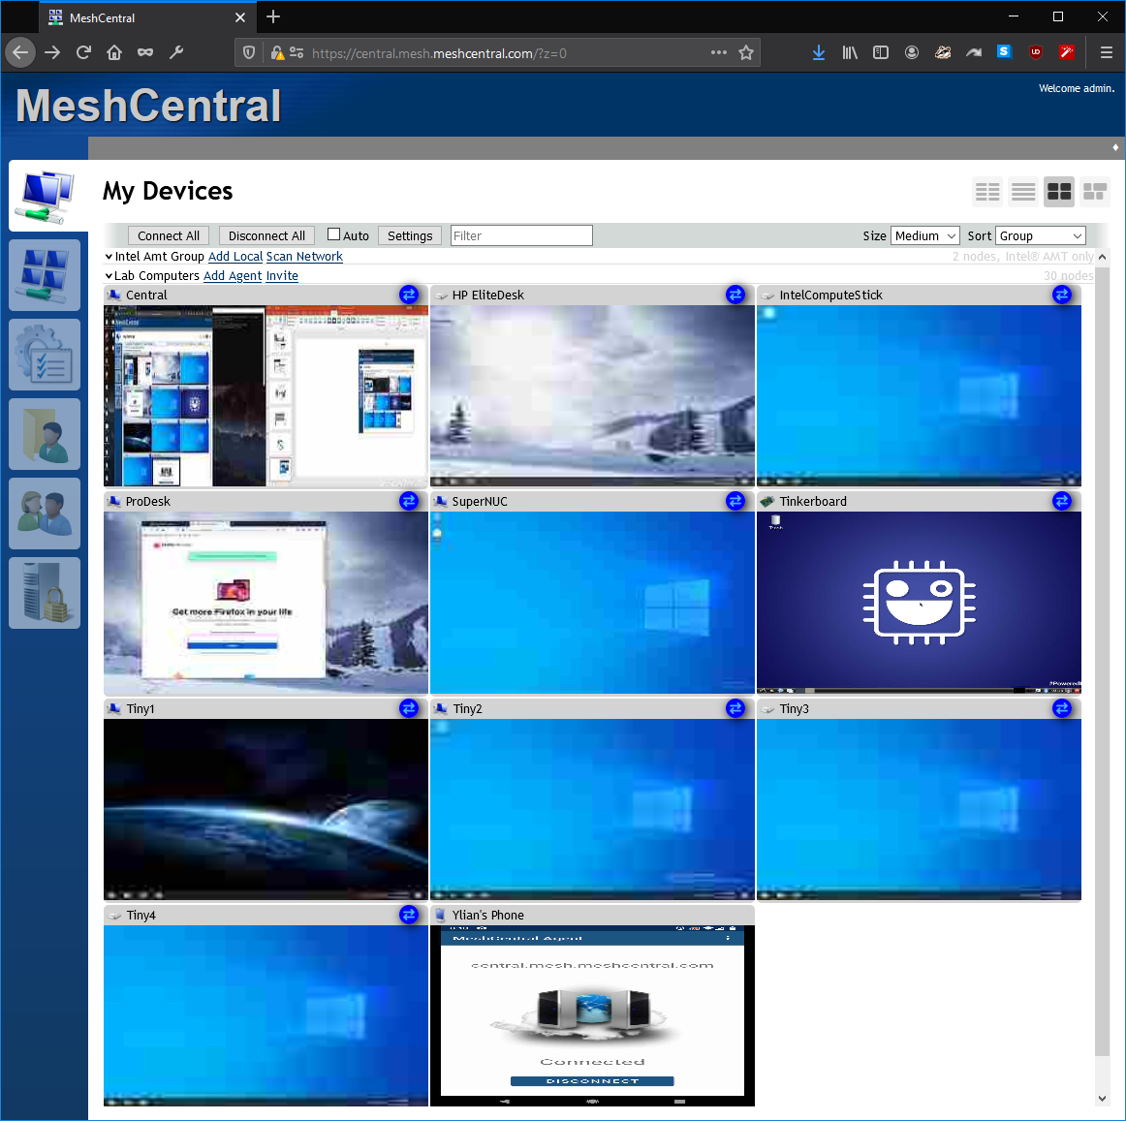
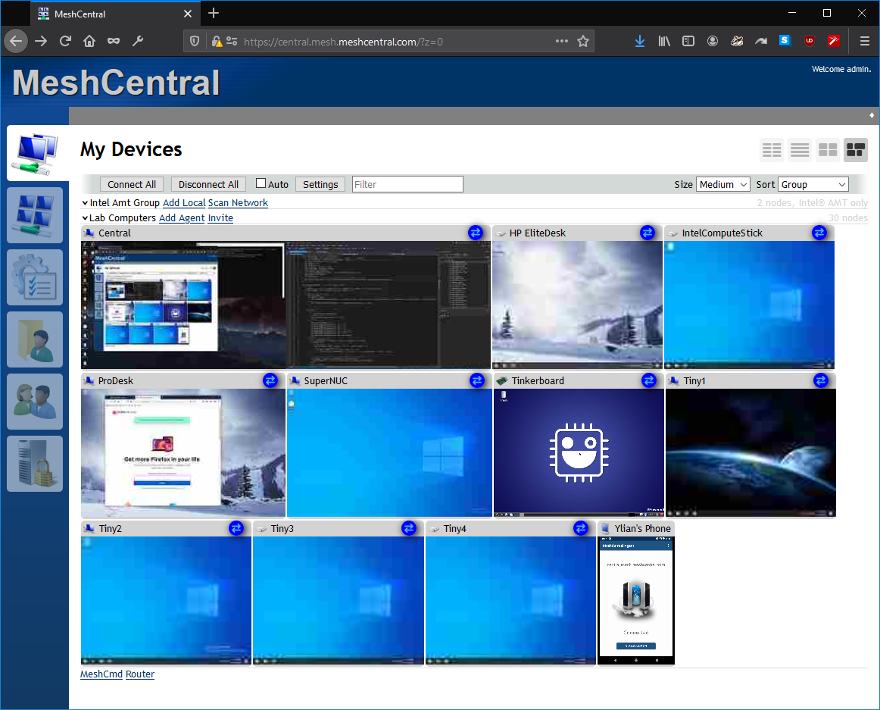
NEW
The multi-desktop view now has both fixed width and variable width views.
In variable width view, device with multiple monitors will show up very wide.
Fixed width mode makes for easy device organization, but the display aspect ratio is distorted.
An Android phone is narrow as expected.

Slide 14
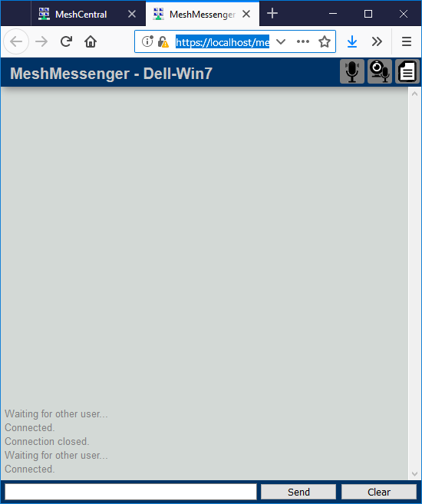
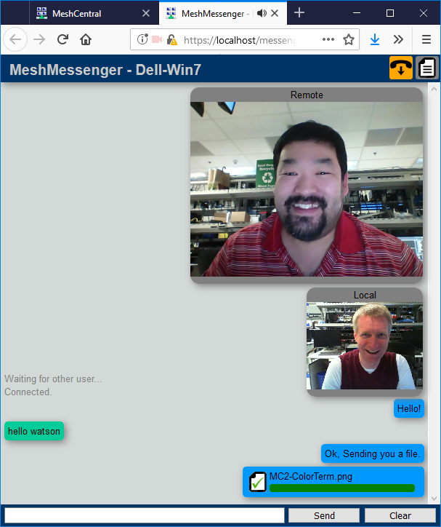

Once connected, WebRTC will be setup for direct browser-to-browser connection.
In addition to file transfer
if WebRTC is successful,
the audio/video icons will appear.
Local and remote windows show the chat session in real time.
Once received, click on the file to save it on the local computer.
Drag & drop a file to send it over.

Slide 15
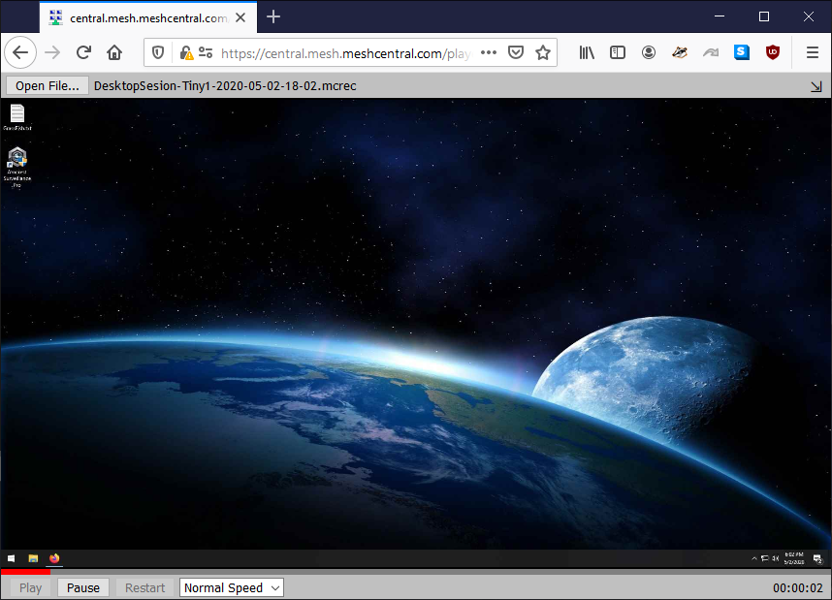
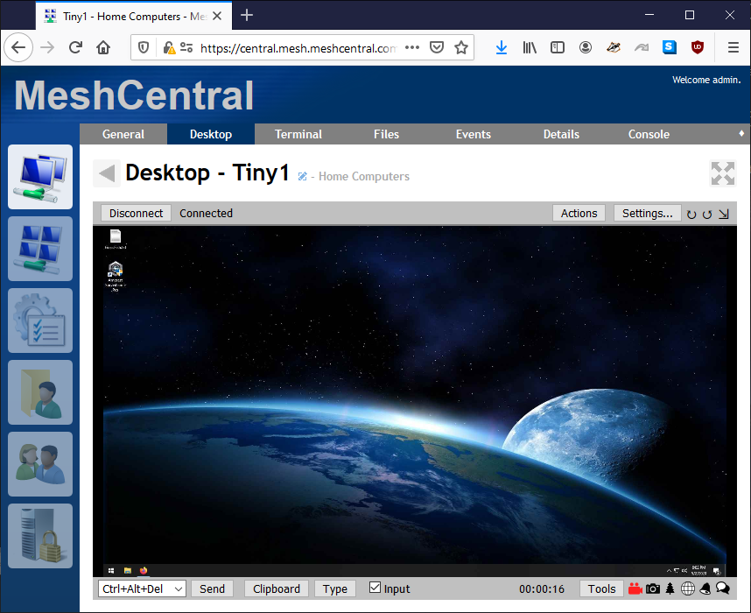

NEW
You can now click the record icon to record the remote desktop session to a local file.
/player.htm
Play back using the MeshCentral web player.
The recording is done in browser memory and saved to disk when the recording ends.

Slide 16
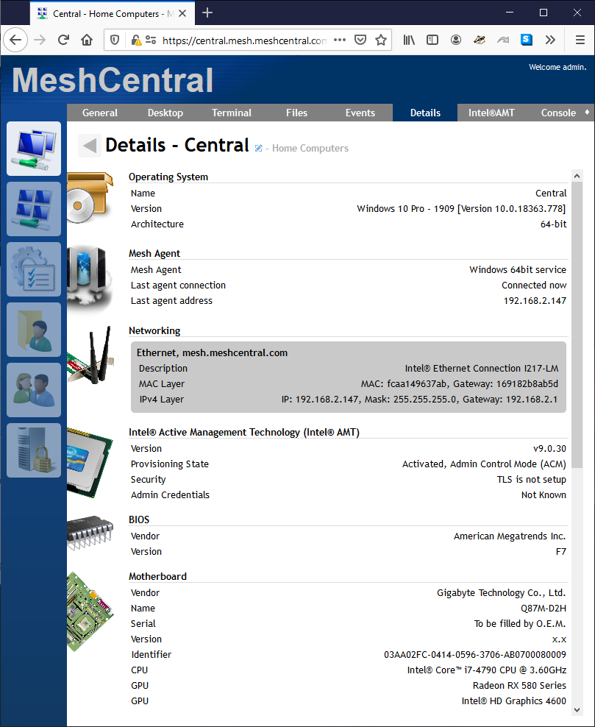
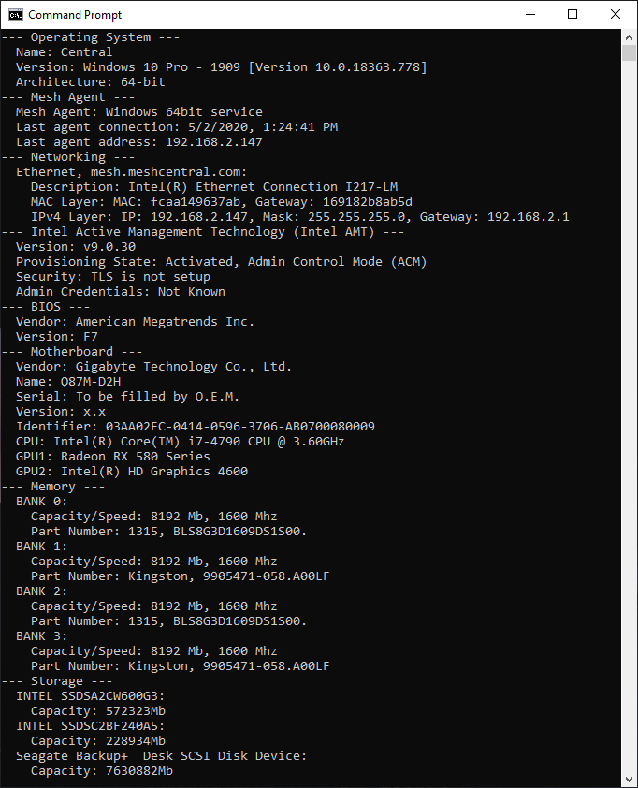
NEW
MeshCtrl new “DeviceInfo” command can easily retrieve device information just like the details tab on the web site.
Web Site - Details tab
MeshCtrl - DeviceInfo
Optionally use the --json or --raw switches to change the output format.

Slide 17

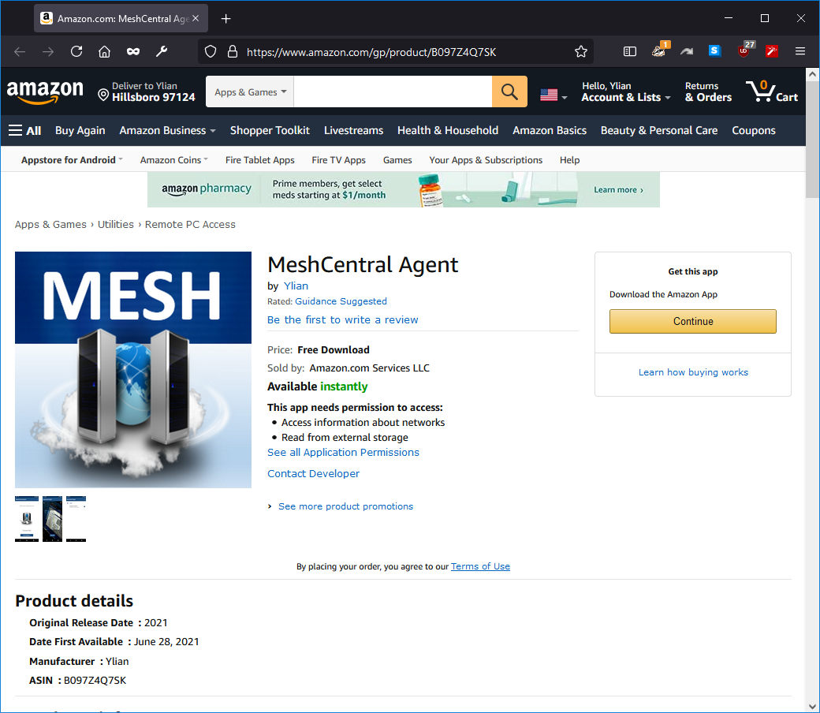

NEW
MeshCentral Agent for Android is not available on the Amazon app store.
Perfect for remotely managing Amazon and other Android devices that are compatible with this store.

Slide 18
MeshCentral
2
HARDWARE TLS
MeshCentral.com

